Slide 1
Simple Processor: Data Path & Control Unit
Adriando Tavares, Pedro X. Matos

Slide 2
Outline
Introduction
Data path
Control Unit
Control unit + Data path
Simulation
On real Hardware

Slide 3
Introduction
This presentation shows you a simple data path and Control Unit of a simple processor;
The circuit was implemented using Verilog Hardware description language;
The simulation will show us the correct behavior of the implemented circuit;
Finaly the circuit will be burned down into your hardware boards;

Slide 4
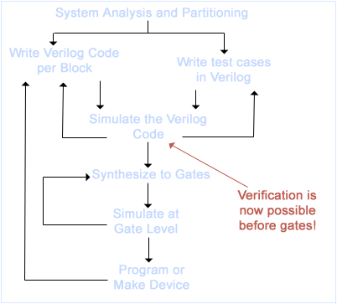
Introduction
Verilog
The Verilog HDL is an IEEE standard hardware description language. It is widely used in the design of digital integrated circuits.
Design Flow

Slide 5
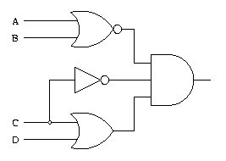
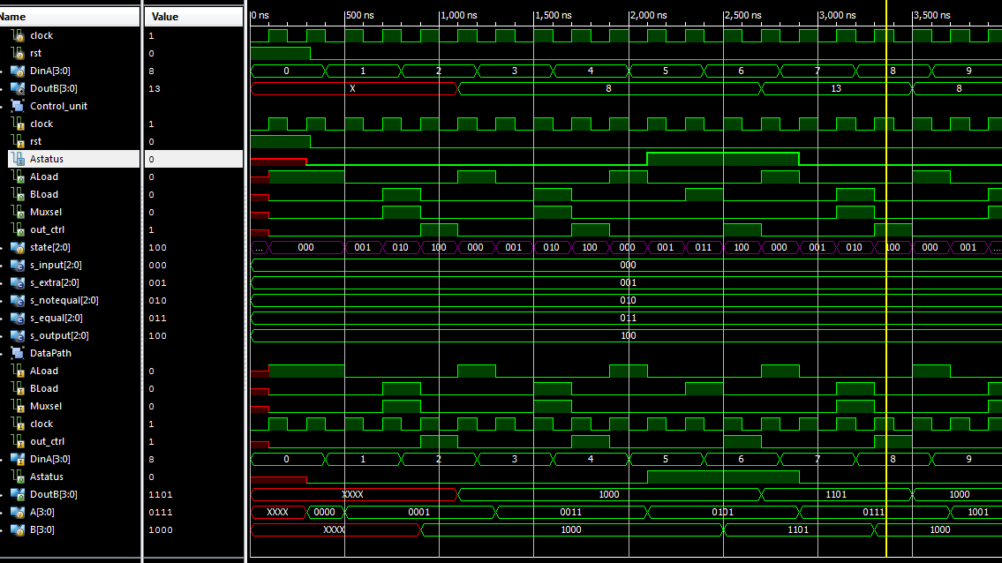
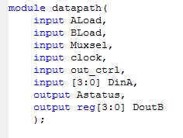
Introduction
Tool
Vivado → Logic synthesize
ISIM simulator → Built-in Vivado → Logic Simulator

Slide 6
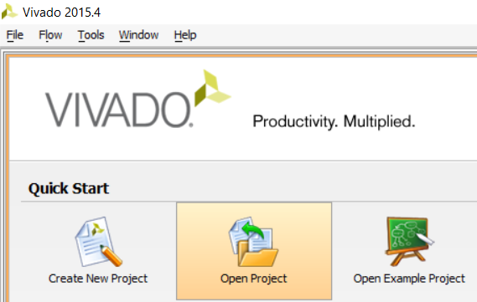
Introduction
Copy the project into your projects folder and then, open the Vivado tool:
Click on, “Open Project”.

Slide 7
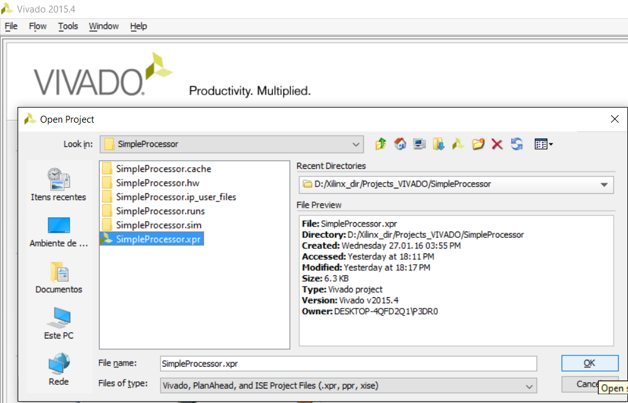
Introduction
Choose the SimpleProcessor project and hit “ok”

Slide 8
Introduction
Choose the SimpleProcessor project and hit “ok”

Slide 9
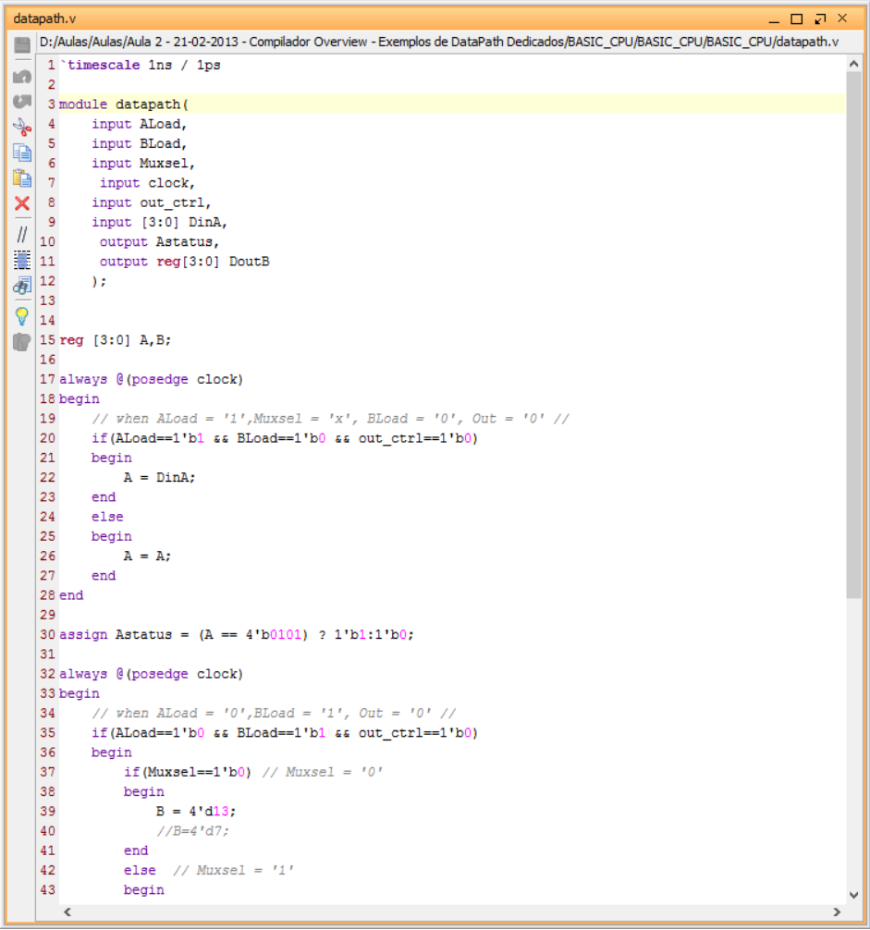
Datapath
Open the datapath.v file and examine it carefully:

Slide 10
Datapath
What is datapath ?
is a set of functional units that carry out data required for processing operations.
The datapath presents several control signals that when activated or deactivated in a given clock cycle allow execution of different RT operations
The execution of an RT operation requires activation or deactivation of each control signals
The control signals of a datapath are grouped in the so-called control word:
A single bit is dedicated to each control signal
Each RT operation is specified by a set of bit in the control word
Combining several control words in a given sequence, the datapath will perform specific operations in a given order, i.e., execute a program

Slide 11
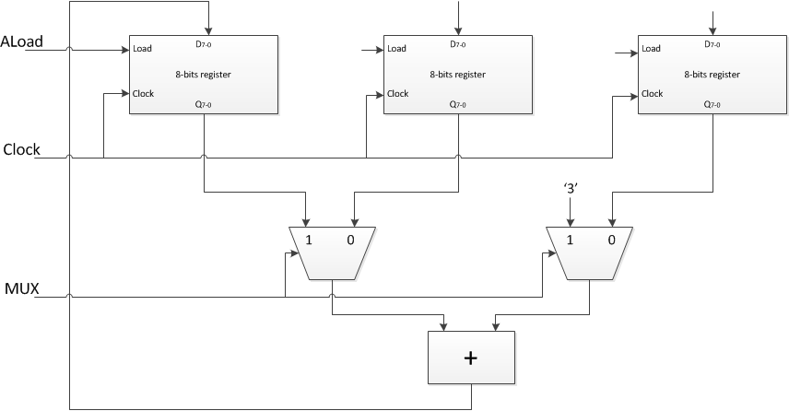
Datapath
Control Word | RT Operation | Control Signal
 |  | ALoad | Mux
1 | A = A + 3 | 1 | 1
2 | A = B + C | 1 | 0

Slide 12
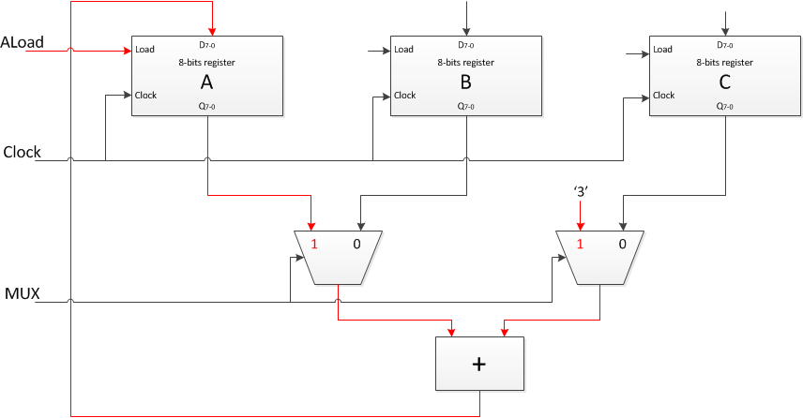
Datapath
Control Word | RT Operation | Control Signal
 |  | ALoad | Mux
1 | A = A + 3 | 1 | 1
2 | A = B + C | 1 | 0

Slide 13
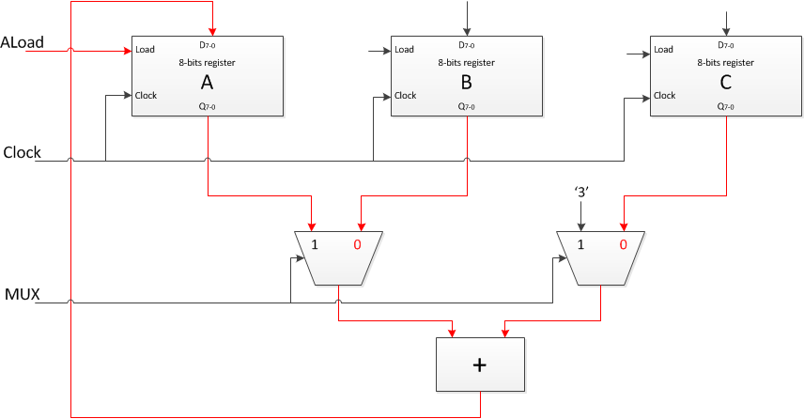
Datapath
Control Word | RT Operation | Control Signal
 |  | ALoad | Mux
1 | A = A + 3 | 1 | 1
2 | A = B + C | 1 | 0

Slide 14
Datapath
Discuss the implementation of a datapath and control unit for the following algorithm:
1 INPUT A
2 IF (A = 5) THEN
3 B = 8
4 ELSE
5 B = 13
6 END IF
7 OUTPUT B

Slide 15
Datapath
Note that by connecting the comparator output directly to the multiplexer input:
The datapath generates one state signal less
And it would be necessary one control signal less
However, there are cases where timing problems will arise if state signals are used directly to drive some control signals
‘8’
‘13’
Input
Muxsel
1
0
4
4
ALoad
D₇₋₀
BLoad
D₇₋₀
Load
4-bits Register A
Load
4-bits Register B
Clock
Clock
Q₃₋₀
Clock
Q₃₋₀
4
4
Out
A₃
(A=5)
Output
A₀
1 INPUT A
2 IF (A = 5) THEN
3 B = 8
4 ELSE
5 B = 13
6 END IF
7 OUTPUT B
Control Word | RT Operation | Control Signals
 |  | ALoad | Muxsel | BLoad | Out
1 | INPUT A | 1 | x | 0 | 0
2 | B = 8 | 0 | 1 | 1 | 0
3 | B = 13 | 0 | 0 | 1 | 0
4 | OUTPUT B | 0 | x | 0 | 1

Slide 16
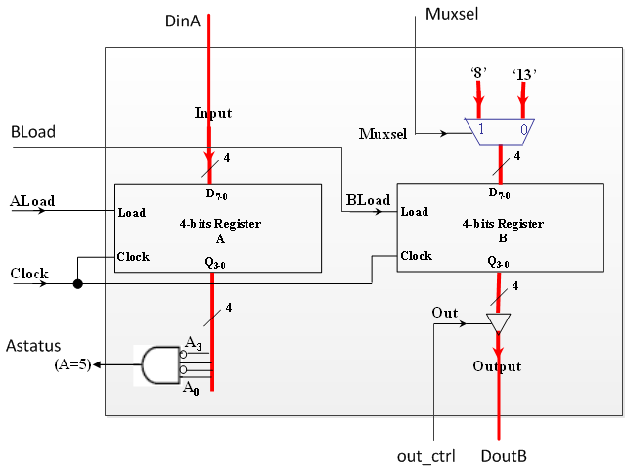
Datapath: interface
How to create in Verilog

Slide 17
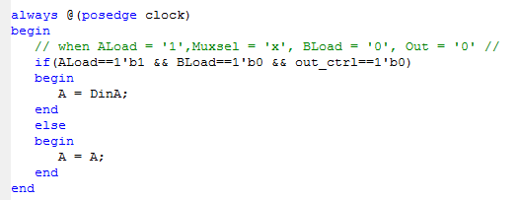
Datapath: internal logic
Control Word | RT Operation | Control Signals
 |  | ALoad | Muxsel | BLoad | Out
1 | INPUT A | 1 | x | 0 | 0
2 | B = 8 | 0 | 1 | 1 | 0
3 | B = 13 | 0 | 0 | 1 | 0
4 | OUTPUT B | 0 | x | 0 | 1

Slide 18
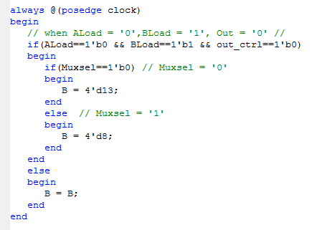
Datapath: internal logic
Control Word | RT Operation | Control Signals
 |  | ALoad | Muxsel | BLoad | Out
1 | INPUT A | 1 | x | 0 | 0
2 | B = 8 | 0 | 1 | 1 | 0
3 | B = 13 | 0 | 0 | 1 | 0
4 | OUTPUT B | 0 | x | 0 | 1

Slide 19
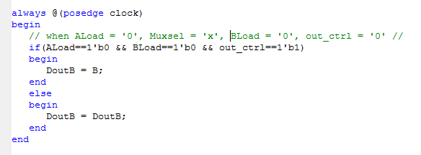
Datapath: internal logic
Control Word | RT Operation | Control Signals
 |  | ALoad | Muxsel | BLoad | Out
1 | INPUT A | 1 | x | 0 | 0
2 | B = 8 | 0 | 1 | 1 | 0
3 | B = 13 | 0 | 0 | 1 | 0
4 | OUTPUT B | 0 | x | 0 | 1

Slide 20
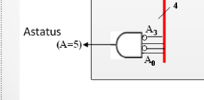
Datapath: internal logic

Slide 21
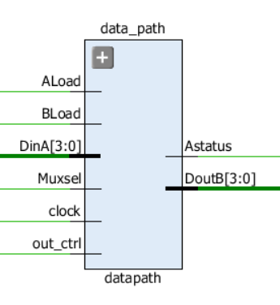
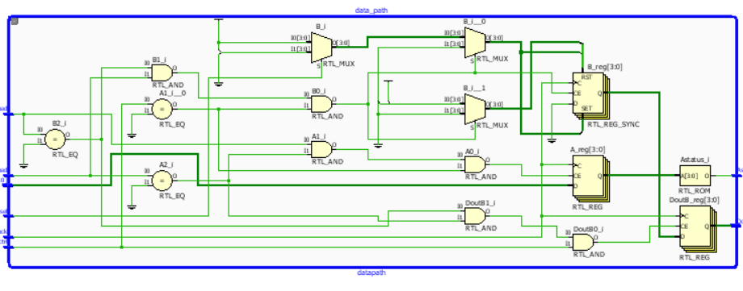
Datapath: interface & internal logic

Slide 22
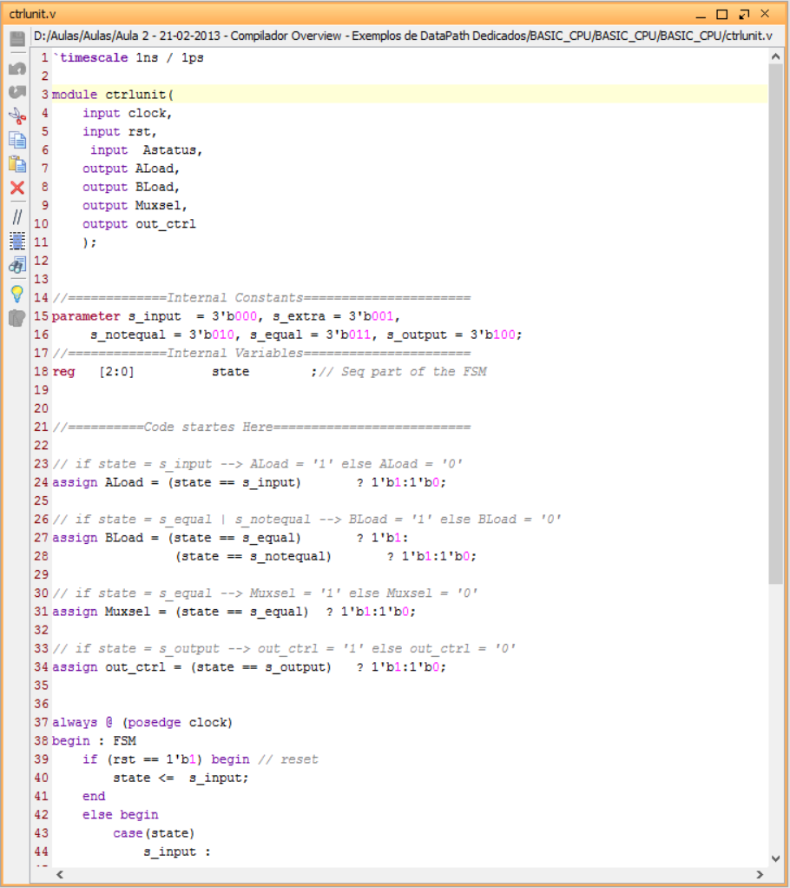
Control unit
Open the ctrlunit.v file and examine it carefully:

Slide 23
Control unit
Control Unit
or in other words a state machine
Each state corresponds to a control word
Each state is executed in a clock cycle
Transitions are dictated by the sequence in which algorithm instructions are executed
Be aware of (due to implementation with a D flip-flop that changes output at rising edge of the clock):
At the rising edge of the clock a register is update with new value if the given signal LOAD is enabled
At each rising edge of the clock, the FSM enters a new state - the next state

Slide 24
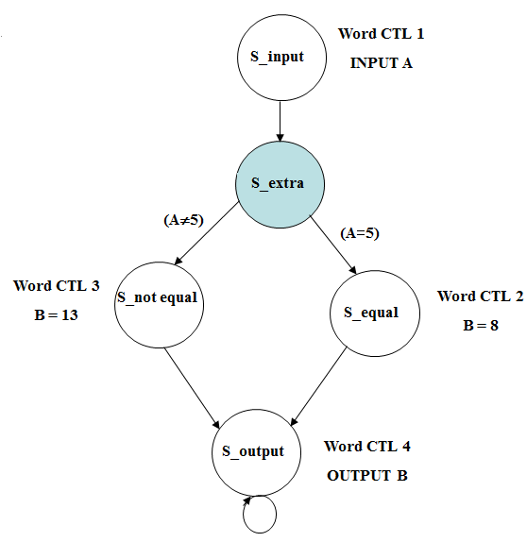
Control unit
Word CTL 1
INPUT A
S_input
(A≠5)
(A=5)
Word CTL 3
B = 13
S_not equal
Word CTL 2
B = 8
S_equal
S_output
Word CTL 4
OUTPUT B

Slide 25
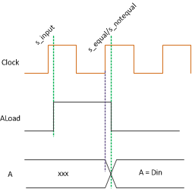
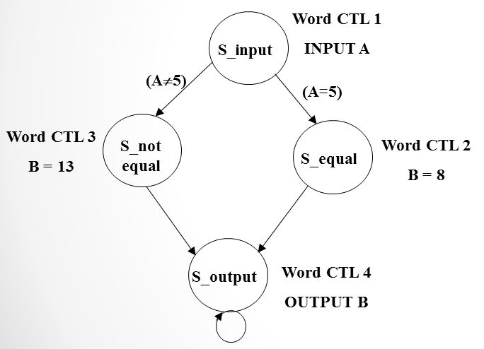
Control unit
Gate delay
The control unit want to load data to register A at the first clock
Aload is not change immediately
The register A at the second clock is not collect. (it’s xxx)

Slide 26
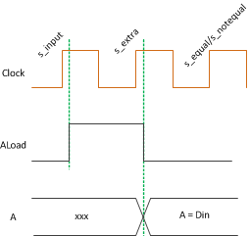
Control unit
Gate delay
The control unit want to load data to register A at the first clock
Aload is not changed immediately

Slide 27
Control unit
Control Unit: Building the next state table
Three registers will be used to encode the five states. For instance:
(000→S_input)
(001→S_extra)
(010→S_notequal)
(011→S_equal)
(100→ S_output)
Due to noise in the circuit, the FSM can reach one of the unused states (101, 110 or 111). Therefore, we assign the state S_input as the next state from these states
Another solution would be using don’t care values​​ to simplify the equations of excitement, if it does not matter which is the next state

Slide 28
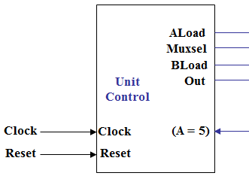
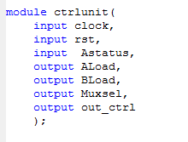
Control unit: interface
How to create in Verilog

Slide 29
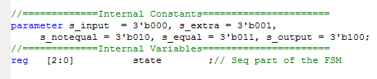
Control unit: FSM
FSM : finite state machine
Create FSM for control unit
Assign constant to each state
How to assign binary value to these state in verilog ?
(000→S_input)
(001→S_extra)
(010→S_notequal)
(011→S_equal)
(100→ S_output)

Slide 30
Control unit
Coding Verilog follow the table
Create FSM as sequential statement
Generate control signal as combination logic
Current State Q₂Q₁Q₀ | Next State Q_{2next}Q_{1next}Q_{0next}
 | (A=5)’ | (A=5)
(S_input, 000) | (S_extra, 001) | (S_extra, 001)
(S_extra, 001) | (S_notequal, 010) | (S_equal, 011)
(S_notequal, 010) | (S_output, 100) | (S_output, 100)
(S_equal, 011) | (S_output, 100) | (S_output, 100)
(S_output, 100) | (S_output, 100) | (S_output, 100)
(unused, 101) | (S_input, 000) | (S_input, 000)
(unused, 110) | (S_input, 000) | (S_input, 000)
(unused, 111) | (S_input, 000) | (S_input, 000)

Slide 31
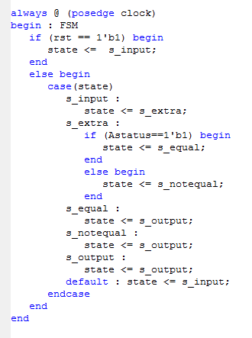
Control unit: next state
FSM’s next state
Current State Q₂Q₁Q₀ | Next State Q_{2next}Q_{1next}Q_{0next}
 | (A=5)’ | (A=5)
(S_input, 000) | (S_extra, 001) | (S_extra, 001)
(S_extra, 001) | (S_notequal, 010) | (S_equal, 011)
(S_notequal, 010) | (S_output, 100) | (S_output, 100)
(S_equal, 011) | (S_output, 100) | (S_output, 100)
(S_output, 100) | (S_output, 100) | (S_output, 100)
(unused, 101) | (S_input, 000) | (S_input, 000)
(unused, 110) | (S_input, 000) | (S_input, 000)
(unused, 111) | (S_input, 000) | (S_input, 000)

Slide 32
Control unit: next state
FSM’s next state
Current State Q₂Q₁Q₀ | Next State Q_{2next}Q_{1next}Q_{0next}
 | (A=5)’ | (A=5)
(S_input, 000) | (S_extra, 001) | (S_extra, 001)
(S_extra, 001) | (S_notequal, 010) | (S_equal, 011)
(S_notequal, 010) | (S_output, 100) | (S_output, 100)
(S_equal, 011) | (S_output, 100) | (S_output, 100)
(S_output, 100) | (S_output, 100) | (S_output, 100)
(unused, 101) | (S_input, 000) | (S_input, 000)
(unused, 110) | (S_input, 000) | (S_input, 000)
(unused, 111) | (S_input, 000) | (S_input, 000)

Slide 33
Control unit: next state
FSM’s next state
Current State Q₂Q₁Q₀ | Next State Q_{2next}Q_{1next}Q_{0next}
 | (A=5)’ | (A=5)
(S_input, 000) | (S_extra, 001) | (S_extra, 001)
(S_extra, 001) | (S_notequal, 010) | (S_equal, 011)
(S_notequal, 010) | (S_output, 100) | (S_output, 100)
(S_equal, 011) | (S_output, 100) | (S_output, 100)
(S_output, 100) | (S_output, 100) | (S_output, 100)
(unused, 101) | (S_input, 000) | (S_input, 000)
(unused, 110) | (S_input, 000) | (S_input, 000)
(unused, 111) | (S_input, 000) | (S_input, 000)

Slide 34
Control unit: next state
FSM’s next state
Current State Q₂Q₁Q₀ | Next State Q_{2next}Q_{1next}Q_{0next}
 | (A=5)’ | (A=5)
(S_input, 000) | (S_extra, 001) | (S_extra, 001)
(S_extra, 001) | (S_notequal, 010) | (S_equal, 011)
(S_notequal, 010) | (S_output, 100) | (S_output, 100)
(S_equal, 011) | (S_output, 100) | (S_output, 100)
(S_output, 100) | (S_output, 100) | (S_output, 100)
(unused, 101) | (S_input, 000) | (S_input, 000)
(unused, 110) | (S_input, 000) | (S_input, 000)
(unused, 111) | (S_input, 000) | (S_input, 000)

Slide 35
Control unit: next state
FSM’s next state
Current State Q₂Q₁Q₀ | Next State Q_{2next}Q_{1next}Q_{0next}
 | (A=5)’ | (A=5)
(S_input, 000) | (S_extra, 001) | (S_extra, 001)
(S_extra, 001) | (S_notequal, 010) | (S_equal, 011)
(S_notequal, 010) | (S_output, 100) | (S_output, 100)
(S_equal, 011) | (S_output, 100) | (S_output, 100)
(S_output, 100) | (S_output, 100) | (S_output, 100)
(unused, 101) | (S_input, 000) | (S_input, 000)
(unused, 110) | (S_input, 000) | (S_input, 000)
(unused, 111) | (S_input, 000) | (S_input, 000)

Slide 36
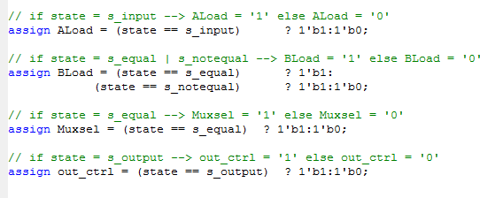
Control unit: FSM output
How to implement a control unit output signals in Verilog
FSM’s output
Q₂Q₁Q₀ | RT Operation | Control Signal
 |  | ALoad | Muxsel | BLoad | Out
000 | INPUT A | 1 | x | 0 | 0
001 | NOP | 0 | x | 0 | 0
010 | B = 8 | 0 | 1 | 1 | 0
011 | B = 13 | 0 | 0 | 1 | 0
100 | OUTPUT B | 0 | x | 0 | 1
101 | NOP | 0 | x | 0 | 0
110 | NOP | 0 | x | 0 | 0
111 | NOP | 0 | x | 0 | 0

Slide 37
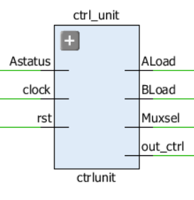
Control unit: interface
After synthesizing, we got the control unit module
What are the expected synthesizer outputs ?

Slide 38
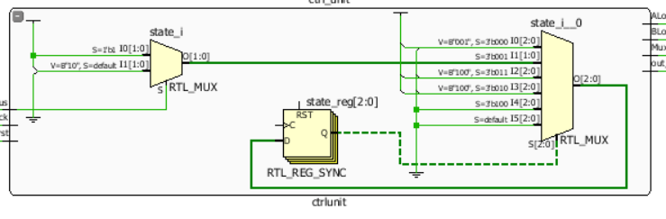
Control unit: internal logic

Slide 39
Control unit + datapath
Finally, the microprocessor will be build by connecting the control unit to the datapath through control and status signals
INPUT A
4
Input
ALoad
Control Signals
ALoad
Muxsel
Muxsel
BLoad
BLoad
Unit Control
Out
Out
Datapath
Clock
Clock
(A = 5)
Status signal
(A = 5)
Clock
Reset
Reset
Reset
4
OUTPUT B

Slide 40
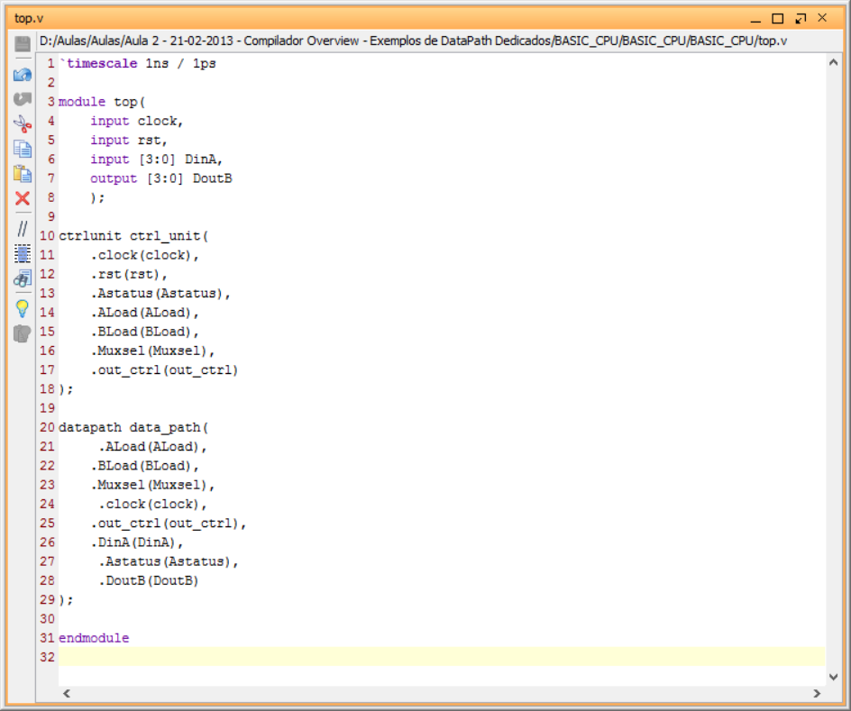
Control unit + datapath
Map two modules together:

Slide 41
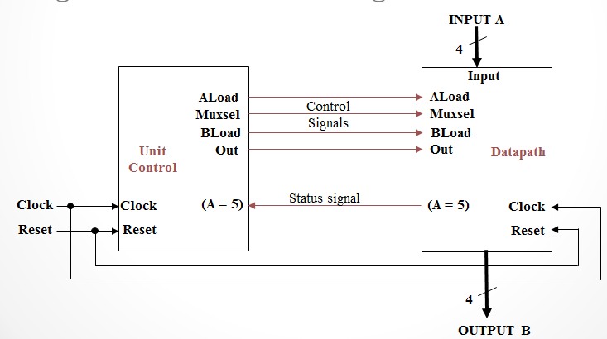
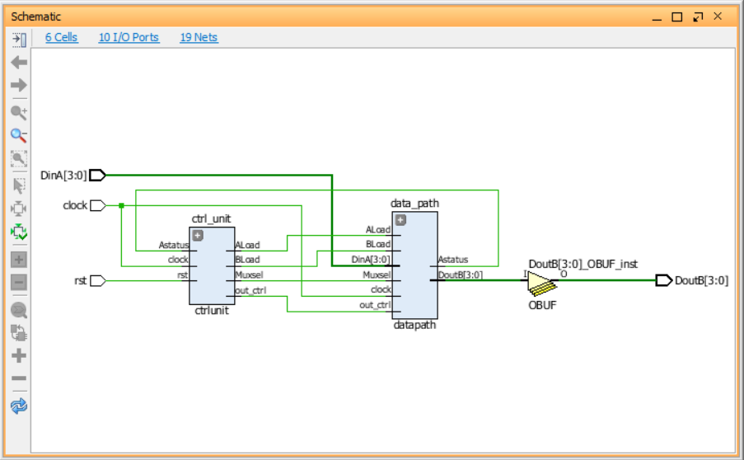
Control unit + datapath
Result:

Slide 42
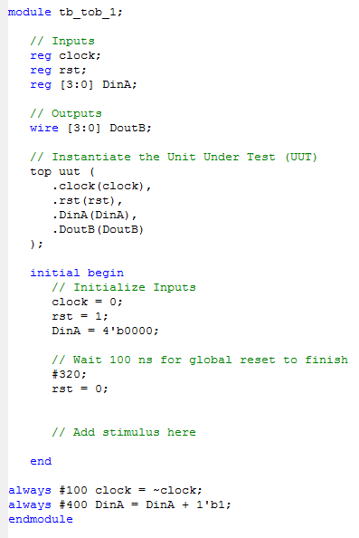
Simulation
Add the following testbench to your project and then verify its behavior:

Slide 43
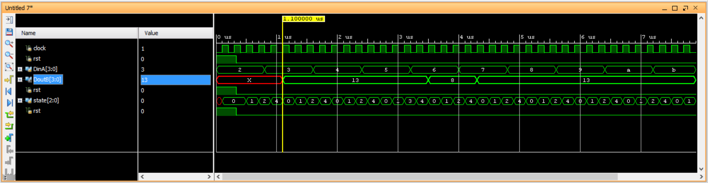
Simulation
Run simulation and observe the outputted waveform:

Slide 44
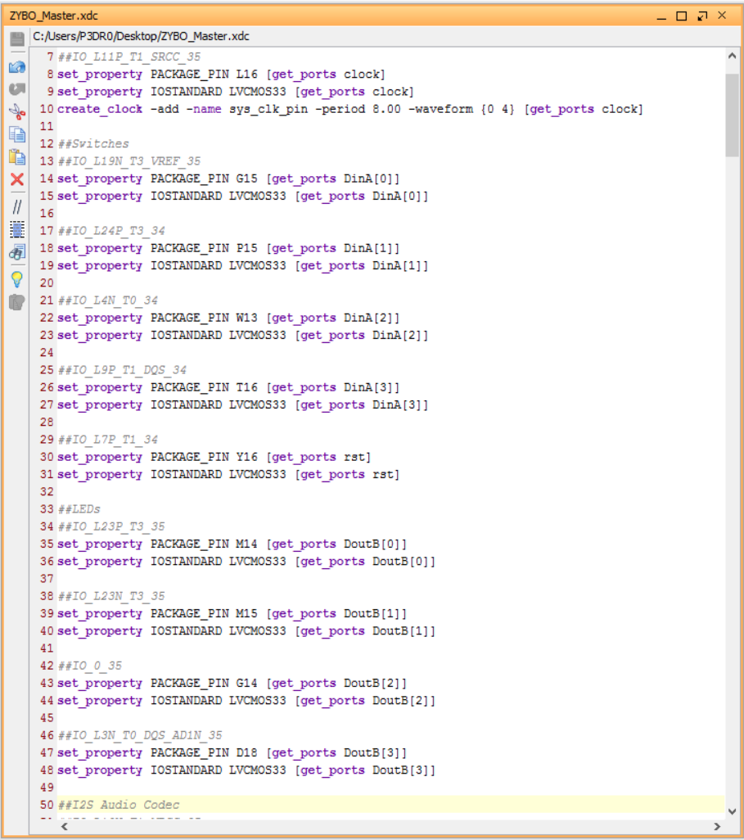
Xilinx description file
Check the *.xdc file:

Slide 45
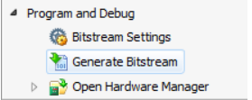
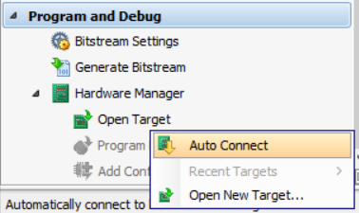
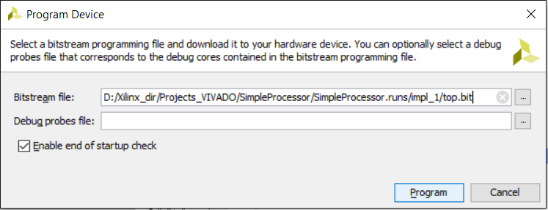
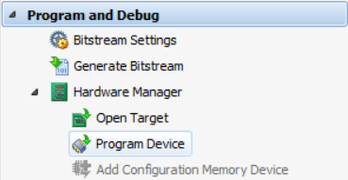
Bitstream
Create the bitstream and burn it into your Zybo device;
Check the functionality on the hardware;

Slide 46

Any doubts ????

